Slide 1

School of Electronics and Communication
Course: Machine Learning (17EECC307)
L-T-P : 2-0-1
Semester: V
Activity 2:
Linear Regression : Univariate linear regression for prediction
Focus of the experiment is :
To make students able to apply the concepts of univariate linear regression on a given problem.
Objectives:
To analyse the given data by applying univariate linear regression.
To visualize the regression model on given data using graphs and plots.
To apply linear regression algorithms for prediction.

Slide 2
School of Electronics and Communication
Course: Machine Learning (17EECC307)
L-T-P : 2-0-1
Semester: V
Activity 2:
Linear Regression : Univariate linear regression for prediction
Exercise 2.1 : Read data from a file (.xlsx) and fit a curve using statistical model and plot the data with appropriate labelling.
2.1.1 First order fit with statistical model.
2.1.2 Second order fit with statistical model.
Exercise 2.2 : Compute cost and minimize using Sum of Square Distances (SSD) for linear regression.
Exercise 2.3 : Cost minimization using gradient descent for linear regression.
2.3.1 Without bias
2.3.2 With bias
2.3.3 For second order polynomial regression

Slide 3
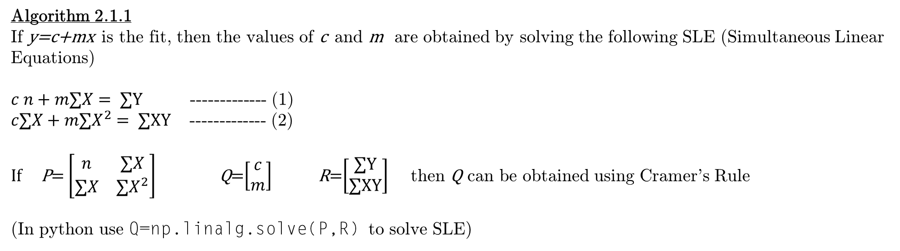
School of Electronics and Communication
Course: Machine Learning (17EECC307)
L-T-P : 2-0-1
Semester: V
Activity 2:
Linear Regression : Univariate linear regression for prediction
Exercise 2.1 : Read data from a file (.xlsx) and fit a curve using statistical model and plot the data with appropriate labelling. 2.1.1 First order fit with statistical model.
2.1.2 Second order fit with statistical model.
Algorithm 2.1.1
If y=c+mx is the fit, then the values of c and m are obtained by solving the following SLE (Simultaneous Linear Equations)
$c n+m∑X= ∑Y$ ------------- (1)
$c∑X+m∑X^{2}= ∑XY$ ------------- (2)
If P= $\left[\begin{matrix}n & ∑X \\ ∑X & ∑X^{2}\end{matrix}\right]$ Q=$\left[\begin{matrix}c \\ m\end{matrix}\right]$ R=$\left[\begin{matrix}∑Y \\ ∑XY\end{matrix}\right]$ then Q can be obtained using Cramer's Rule
(In python use Q=np.linalg.solve(P,R) to solve SLE)
Where, X and Y are the vectors of given data of length n.

Slide 4
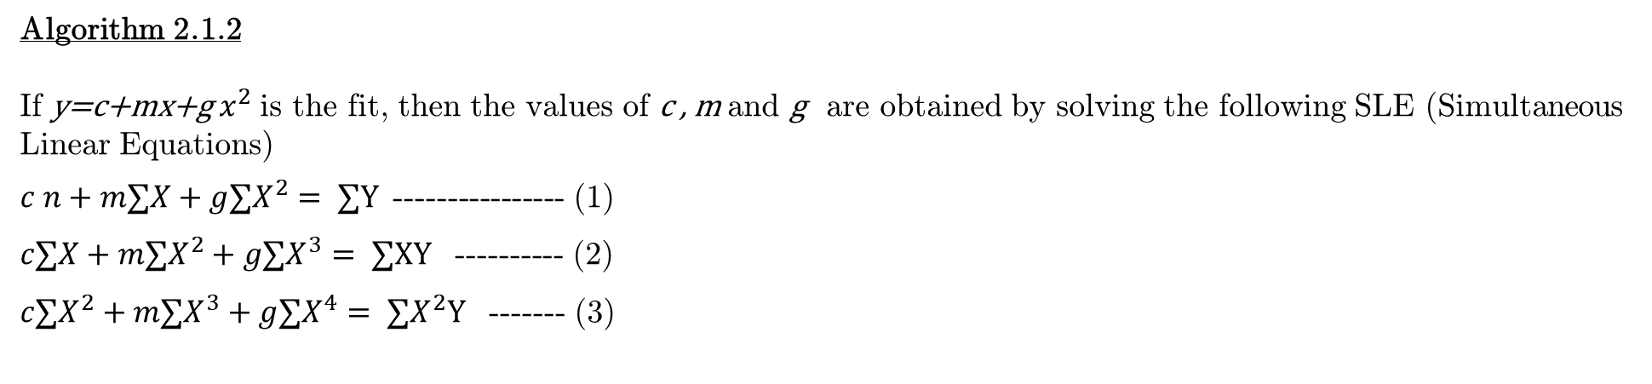
School of Electronics and Communication
Course: Machine Learning (17EECC307)
L-T-P : 2-0-1
Semester: V
Activity 2:
Linear Regression : Univariate linear regression for prediction
Exercise 2.1 : Read data from a file (.xlsx) and fit a curve using statistical model and plot the data with appropriate labelling. 2.1.1 First order fit with statistical model.
2.1.2 Second order fit with statistical model.
Algorithm 2.1.2
If y=c+mx+g $x^{2}$ is the fit, then the values of c , m and g are obtained by solving the following SLE (Simultaneous Linear Equations)
$c n+m∑X+g∑X^{2}= ∑Y$---------------- (1)
$c∑X+m∑X^{2}+g∑X^{3}= ∑XY$ ---------- (2)
$c∑X^{2}+m∑X^{3}+g∑X^{4}= ∑X^{2}Y$ ------- (3)
Where, X and Y are the vectors of given data of length n.

Slide 5
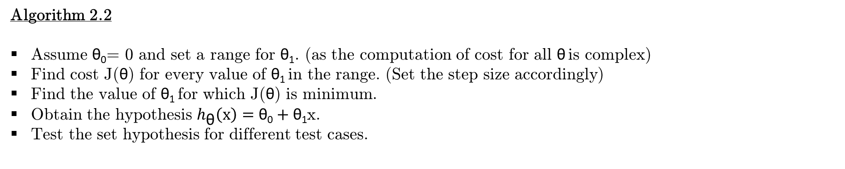
School of Electronics and Communication
Course: Machine Learning (17EECC307)
L-T-P : 2-0-1
Semester: V
Activity 2:
Linear Regression : Univariate linear regression for prediction
Exercise 2.2 : Compute cost and minimize using Sum of Square Distances (SSD) for linear regression.
Algorithm 2.2
Assume θ₀= 0 and set a range for θ₁. (as the computation of cost for all θ is complex)
Find cost J(θ) for every value of θ₁ in the range. (Set the step size accordingly)
Find the value of θ₁ for which J(θ) is minimum.
Obtain the hypothesis $h_{\text{θ}}\left(x\right)=\text{θ}\text{0}+\text{θ}\text{1}$x.
Test the set hypothesis for different test cases.

Slide 6

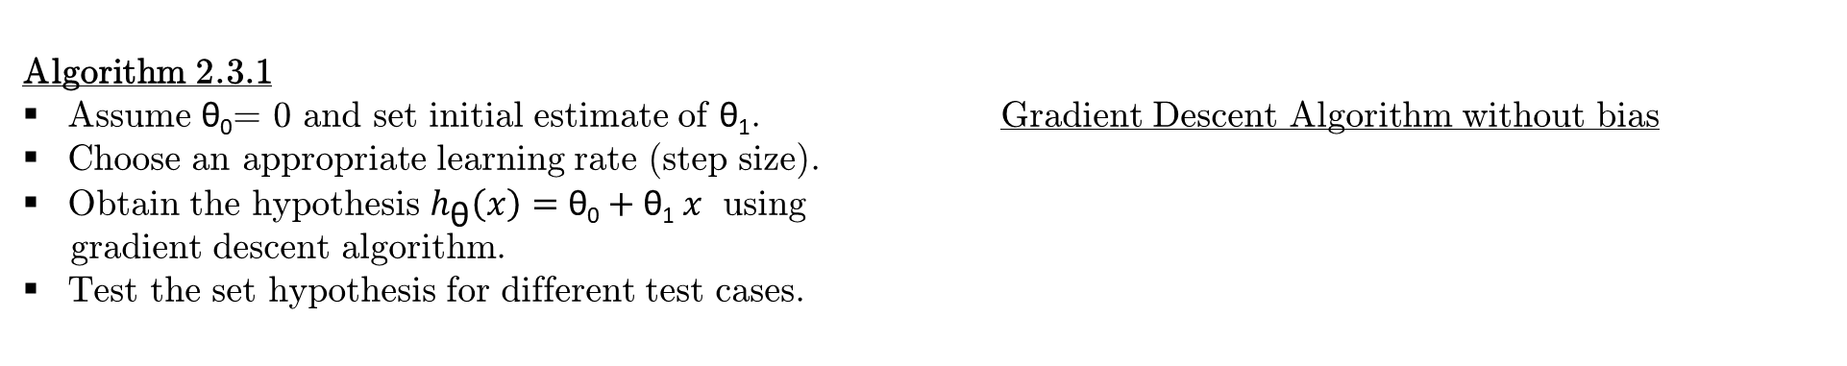
School of Electronics and Communication
Course: Machine Learning (17EECC307)
L-T-P : 2-0-1
Semester: VI
Activity 2:
Linear Regression : Univariate linear regression for prediction
Exercise 2.3 : Cost minimization using gradient descent for linear regression.
2.3.1 Without bias
2.3.2 With bias
2.3.3 For second order polynomial regression
Algorithm 2.3.1
Assume θ₀= 0 and set initial estimate of θ₁. Gradient Descent Algorithm without bias
Choose an appropriate learning rate (step size).
Obtain the hypothesis $h_{\text{θ}}\left(x\right)=\text{θ}\text{0}+\text{θ}\text{1}$ $x$ using
gradient descent algorithm.
Test the set hypothesis for different test cases.

Slide 7
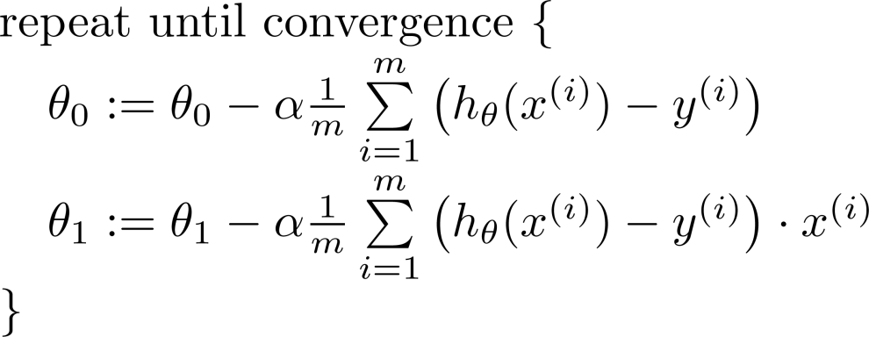
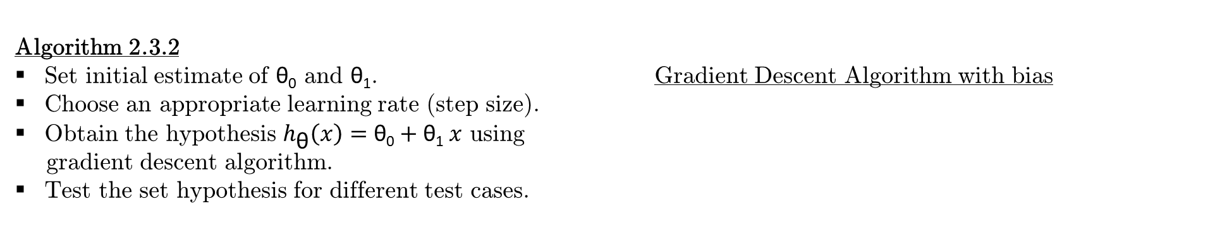
School of Electronics and Communication
Course: Machine Learning (17EECC307)
L-T-P : 2-0-1
Semester: V
Activity 2:
Linear Regression : Univariate linear regression for prediction
Exercise 2.3 : Cost minimization using gradient descent for linear regression.
2.3.1 Without bias
2.3.2 With bias
2.3.3 For second order polynomial regression
Algorithm 2.3.2
Set initial estimate of θ₀ and θ₁. Gradient Descent Algorithm with bias
Choose an appropriate learning rate (step size).
Obtain the hypothesis $h_{\text{θ}}\left(x\right)=\text{θ}\text{0}+\text{θ}\text{1}$ $x$ using
gradient descent algorithm.
Test the set hypothesis for different test cases.

Slide 8
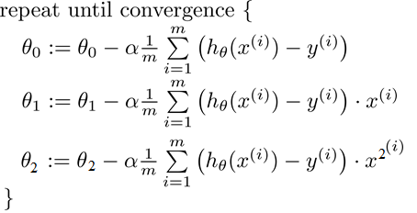
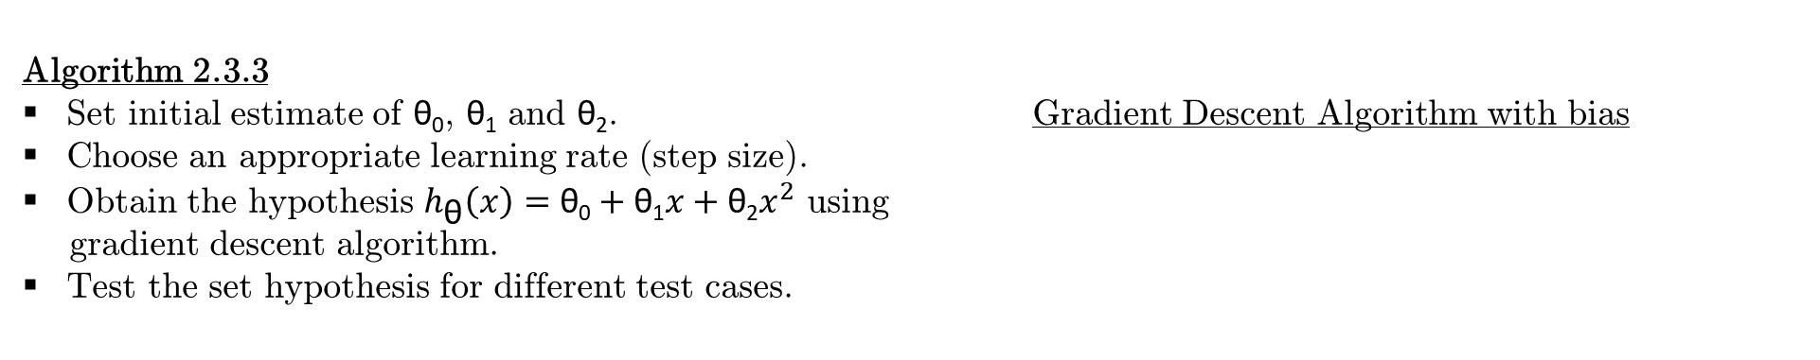
School of Electronics and Communication
Course: Machine Learning (17EECC307)
L-T-P : 2-0-1
Semester: V
Activity 2:
Linear Regression : Univariate linear regression for prediction
Exercise 2.3 : Cost minimization using gradient descent for linear regression.
2.3.1 Without bias
2.3.2 With bias
2.3.3 For second order polynomial regression
Algorithm 2.3.3
Set initial estimate of θ₀, θ₁ and θ₂. Gradient Descent Algorithm with bias
Choose an appropriate learning rate (step size).
Obtain the hypothesis $h_{\text{θ}}\left(x\right)=\text{θ}\text{0}+\text{θ}\text{1}x+\text{θ}\text{2}x^{2}$ using
gradient descent algorithm.
Test the set hypothesis for different test cases.

Slide 9
School of Electronics and Communication
Course: Machine Learning (17EECC307)
L-T-P : 2-0-1
Semester: V
Activity 2:
Linear Regression : Univariate linear regression for prediction
Problem Statement:
A customer wants to invest in shares today and has the share value data of 10 shortlisted companies for last 100 days. The customer wants to predict the benefits and choose top 3 companies to maximize his profits. Assist the customer by designing a predictor to provide the share value of the next three consecutive days for all 10 companies and select 3 companies to invest. The customer also wants to divert his funds after a week, assist him to choose the companies to invest.
Design an algorithm to fit an linear regression model to the given data and predict the share value.
Use polynomial regression to predict the share value.
Plot the graph of initial data and processed data, so that we can present the visualization of the developed algorithm to the customer, and justify the prediction.

Slide 10
School of Electronics and Communication
Course: Machine Learning (17EECC307)
L-T-P : 2-0-1
Semester: V
Activity 2:
Linear Regression : Univariate linear regression for prediction
Input Data:
File Name: Activity2-Data.xlsx
Column 1: Days.
Column 2 to Column 11: Share value of Company-1 to Company-10 respectively.
Expected output:
Regression model for all 10 companies.
Name of top three companies to invest today.
Name of top three companies to invest after a week.

